Slide 1
Using Virtual Reality on Software Engineering and Education
Ayse Betul Cengiz

Slide 2
Contents
What is VR
History of VR
Applications in Education
Applications in Software Engineering (SE)
Applications in SE Education

Slide 3
Virtual Reality (VR)
A simulation to experience desired things outside of the real world
Zeltzer: VR is an interactive and immersive (with the feeling of presence) experience in a simulated (autonomous) world and this measure we will use to determine the level of the advance of VR systems

Slide 4
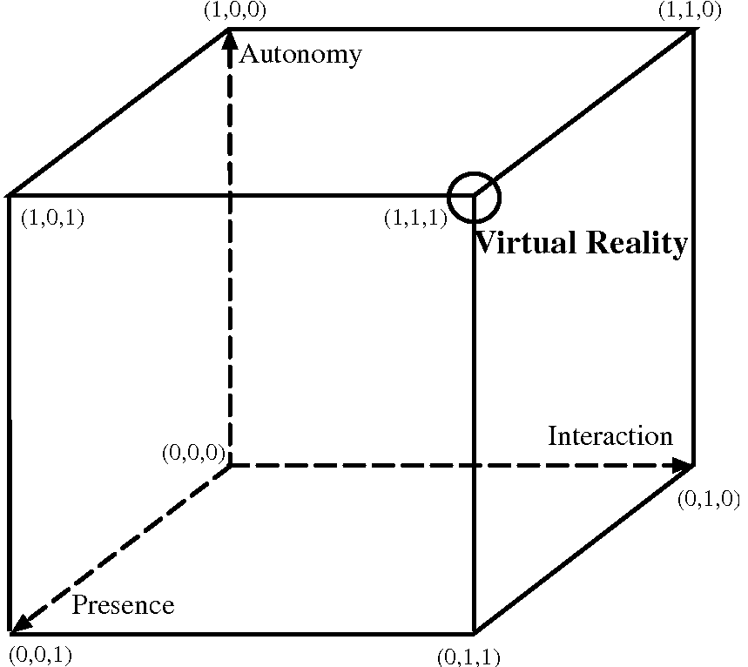
Zeltzer’s Cube

Slide 5
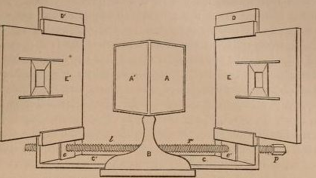
History
From 17th and 18th centuries
Charles Wheatstone
Luminous effects
Notes:
Modern gozukse de eski. Victorian VR donemi. Ilk orneklerden biri gorseldeki isik yansitma oyunu. Yanilsama teknigi. Daha modern donemlerde VR bilim kurgudan dogmustur,

Slide 6
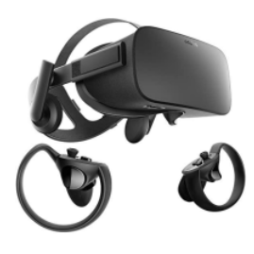
Today
Two main components:
Head mounted display (HMD)
Controllers
Notes:
1991 de |Sega ilk oalrak arcade oyunlar icin VR headset ve Mega drive konsolunu cikarmistir.
2015 te Oneplus firmasi ilk olarak VR kullanan bir urun cikarmistir.
2016 vr yili.

Slide 7
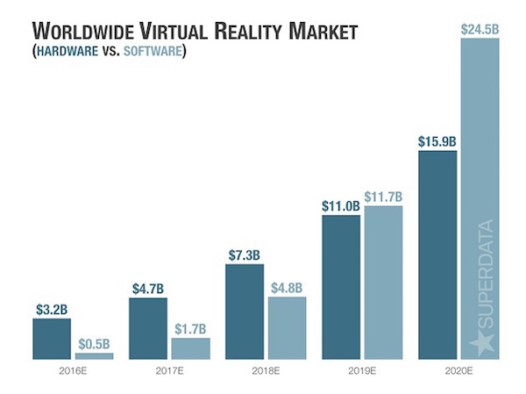

Slide 8
Applications in education
Science:
Chemical engineering
Physics
Astronomy
Medicine:
Injury
Laparoscopy
Dental
Studies on wearables
Notes:
Kimya, fizik lab
Gok cisimlerini anlayabilmek icin
Yaralanmalar icin …
Bir de giyilen cihazlarin etkileri ve gelistirilmesi uzerine calismalar.

Slide 9
Applications in Software Engineering (SE)
SE
SE Education
To improve developers’ performance
To provide suitable ambIance
To teach SE topics
To improve background
Notes:
SE kendi islevsel kullanimi ve egitimi icin kullanilmasi

Slide 10
VR in SE
Three main benefits:
Depth: makes active the decision-making and creativity mechanisms providing spatial involvement
Movement: Aristotle
Plasticity: Creating desired environments
Notes:
Yazilimcilara 3 boyut saglanarak yaraticiligin artmasi planlanmis
Microsoft – data mountain
Aristonun Peripatetik okulu – peripatik yuruyenler demek – Aristonun ogrencileri pesinde yururmus – Bu tarz fazla efor gerektirmeyen hareketlerin ogrenme surecini kolaylastirdigini ve yaraticiligi artirdigi iddia ediliyor. Bu fikirden yola cikarak leeb ve perez-marcos bir calisma yapiyor –VR ortaminda takan kisilerin bacaklarini haraket ettirdigini dusunerek (aslinda avatar hareket ediyor) bu performansi olumlu etkilemis.
Esneklik – Rift Sketch – immersion en bilindik iki uygulama – yazilimcilara bulunmak istedikleri hos ortamlar saglanarak performans artirma.

Slide 11
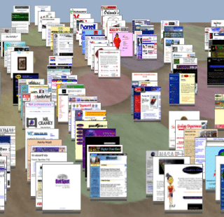
Applications
Data Mountain: 3D Desktop for document management
Notes:
98 de cikarilmis. Herhangi bir donanima ihtiyac yok. 3d masaustunun ilk uygulamasi. Dosya managment

Slide 12
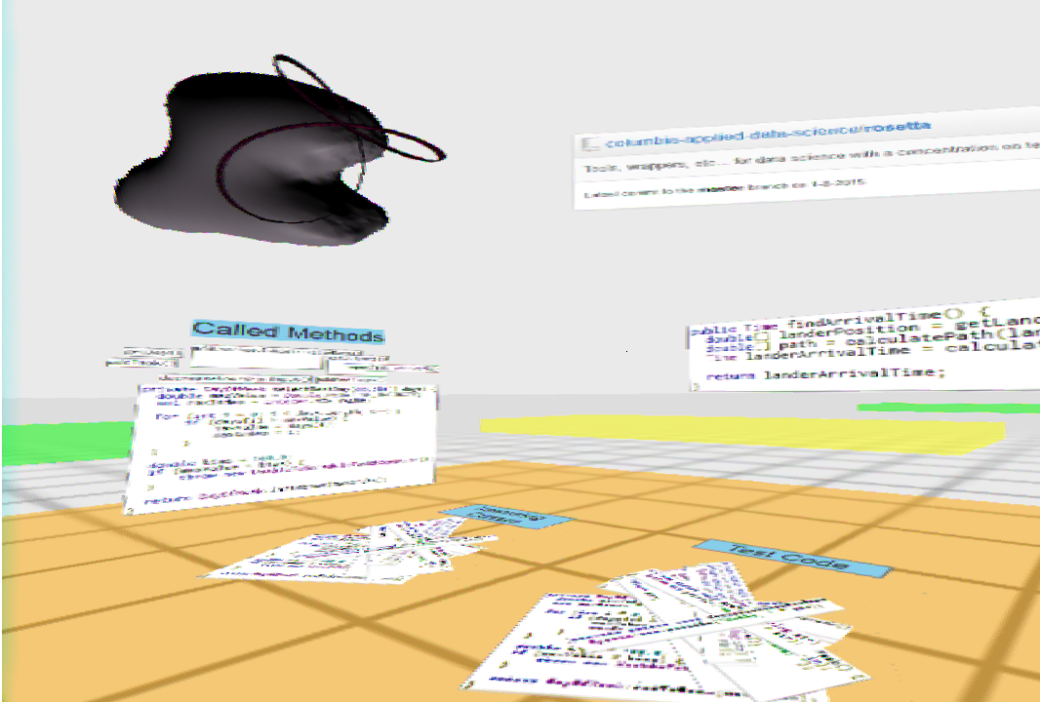
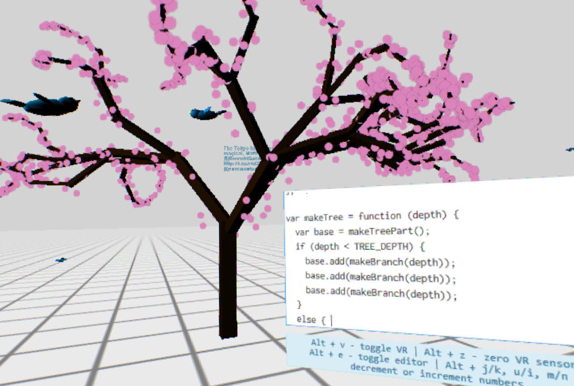
Applications cont.
Immersion: Live coding and code review (Left)
RiftSkecth: Live coding (Right)

Slide 13
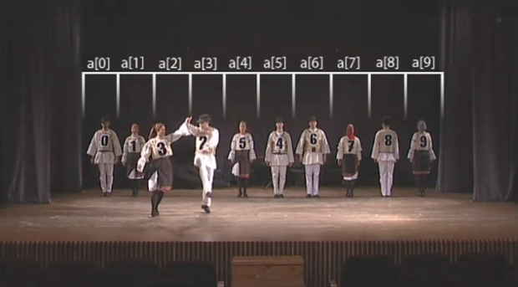
VR in SE Education
2015:
Studies on RiftSkecth and Immersion
2017:
Depicting codes and software as buildings
Exploring benefits of VR
2018:
VRENITE: to help to teach sorting algorithms
2019:
UML
OOP
To help understand some processes

Slide 14
References
Andrade et al. (2022) Virtual Reality Applications in Software Engineering Education: A Systematic Review
Dominic et al. (2020) Remote Pair Programming in Virtual Reality
Sharma et al. (2018) An immersive future for software engineering: avenues and approaches
Akbulut et al. (2017) On the effectiveness of virtual reality in the education of software engineering
Elliott et al. (2015) Virtual Reality in Software Engineering: Affordances, Applications, and Challenges

